Slide 1
Object-Oriented Programming
WEEK 08 Abeeha Sattar

Slide 2
Types of Relationships:
Has – a / has – an
An object contains one or more objects of other classes as members
Association/Aggregation/Composition fall into this category
Is – a / is – an
A class is an extension of another class
Inheritance falls into this category

Slide 3
Association in OOP
Association is a relationship between two objects.
It defines the multiplicity between objects. Some of the multiplicities are:
one-to-one, 1 1
one-to-many, 1 *
many-to-one, * 1
many-to-many. * *
You can have other numbers as multiplicities as well

Slide 4
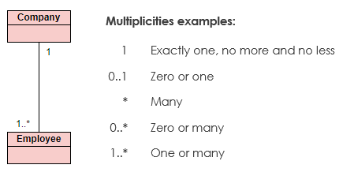
More on Multiplicity

Slide 5
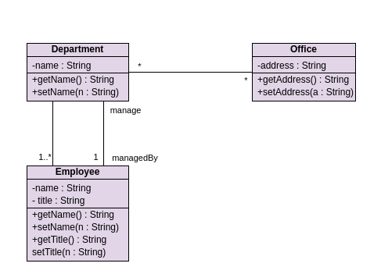
Example of Association

Slide 6

Aggregation
Aggregation is a specialized form of association between two or more objects in which each object has its own life cycle but there exists an ownership as well.
Aggregation is also called a “Has-a” relationship.
Aggregation is usually represented in UML using a line with a hollow diamond towards the class that owns the other object.

Slide 7

Composition
Composition is a special case of aggregation.
In a more specific manner, a restricted aggregation is called composition.
When an object contains the other object, if the contained object cannot exist without the existence of container object, then it is called composition.
Composition is represented in UML using a line connecting the objects with a solid diamond at the end of the object that owns the other object.
Notes:
https://javapapers.com/oops/association-aggregation-composition-abstraction-generalization-realization-dependency/
https://www.infoworld.com/article/3029325/exploring-association-aggregation-and-composition-in-oop.html

Slide 8
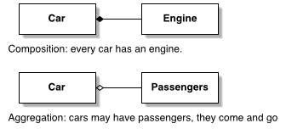







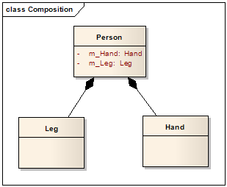
Examples
Note that these are partial class diagrams.
We’ll always be making complete ones!
Window
Scrollbar
1
1
Titlebar
1
1
Menu
1
1 ..

Slide 9
Inheritance in OOP
Sometimes, one class is an extension of another class
OR…
Sometimes, one class is derived from another class
ORRRRR…
Sometimes, one class is a child of another class?

Slide 10

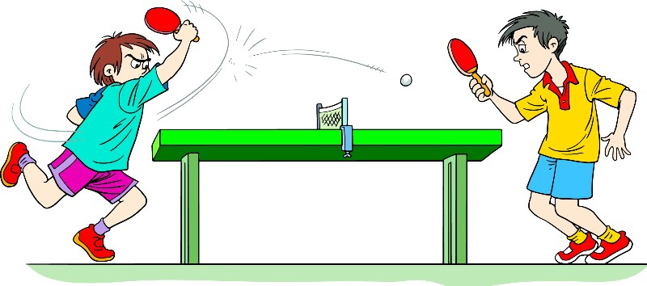

Examples
A car is-a vehicle
A truck is-a vehicle
Cricket is-a sport
Table Tennis is-a sport
Spider is-an arachnid
Scorpion is-an arachnid

Slide 11

More on Inheritance
The extended (or child) class contains all the features of its base (or parent) class, and may additionally have some unique features of its own.
In a class diagram, you use an arrow from child to parent class to show inheritance. The head of the arrow will be towards the parent.
Therefore, it allows us to derive properties from another class while programming, and saves a lot of effort that might be needed to rewrite the same code over and over!

Slide 12
Important Concepts
Super Class
Sub Class
The class whose attributes will be inherited by the derived class
You can call it any of the following:
A base class
A super class
A parent class
The class that inherits the properties from another class
You can call it any of the following:
A derived class
A sub class
A child class

Slide 13
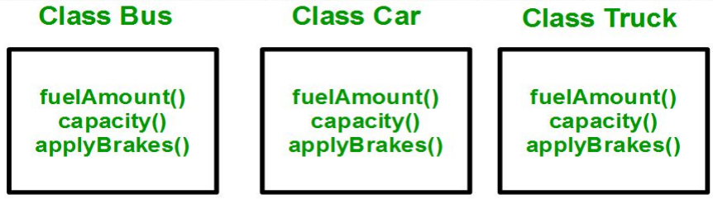
Where and when do we need Inheritance?
Consider a group of vehicles. You need to create classes for Bus, Car and Truck. The methods fuelAmount(), capacity(), applyBrakes() will be same for all of the three classes
Bus
Car
Truck
fuelAmount()
capacity()
applyBrakes()
BAD!!!!!!

Slide 14
Where and when do we need Inheritance?
Why is it bad?
Duplication of code
What’s wrong with that?
Increase in lines of code
More code = more chances for error
Redundant Code =
Not reusing code =
Redundant Code…
oh…
wait…

Slide 15
How to solve the issue?
You may have noticed that car, bus and truck can be categorized as vehicles
We can create a Vehicle class, then,
Add the three common methods to the class
Inherit each of the classes from the Vehicle class
Viola! Reusable code without any redundancy!!

Slide 16
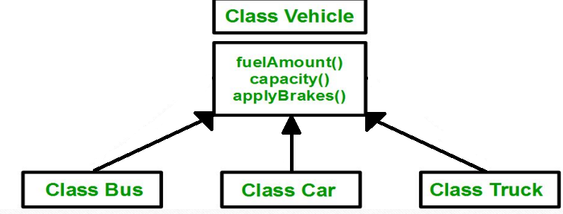
Solution: (Partial Class Diagram)

Slide 17
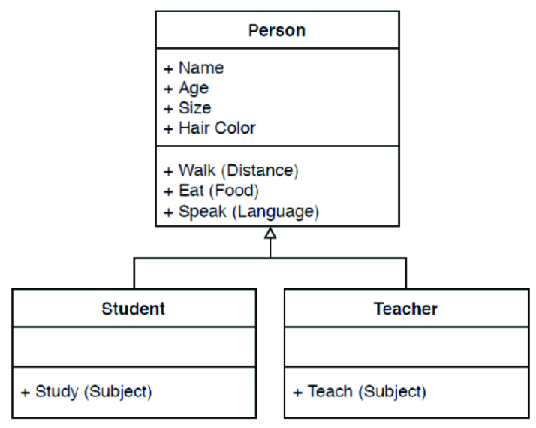
Class Diagram showing Inheritance

Slide 18
How Does Inheritance Look in Code?
class Vehicle {
//class contents
}
class Car extends Vehicle {
// class contents
}

Slide 19
The Protected Modifier
Visibility modifiers determine which class members are inherited and which are not
Variables and methods declared with public visibility are inherited; those with private visibility are not
But public variables violate the principle of encapsulation
There is a third visibility modifier that helps in inheritance situations: protected

Slide 20
The Protected Modifier
The protected modifier allows a member of a base class to be inherited into a child
Protected visibility provides more encapsulation than public visibility does
However, protected visibility is not as tightly encapsulated as private visibility
Protected variables and methods can be shown with a # symbol preceding them in UML diagrams.

Slide 21
The “super” Reference
Constructors are not inherited, even though they have public visibility.
Yet we often want to use the parent's constructor to set up the "parent's part" of the object
The super reference can be used to refer to the parent class, and often is used to invoke the parent's constructor

Slide 22
The “super” Reference
A child’s constructor is responsible for calling the parent’s constructor
The first line of a child’s constructor should use the super reference to call the parent’s constructor
The super reference can also be used to reference other variables and methods defined in the parent’s class

Slide 23
Fin.
: 3

